Slide 1
Task: Above-and-Beyond 3

Slide 2
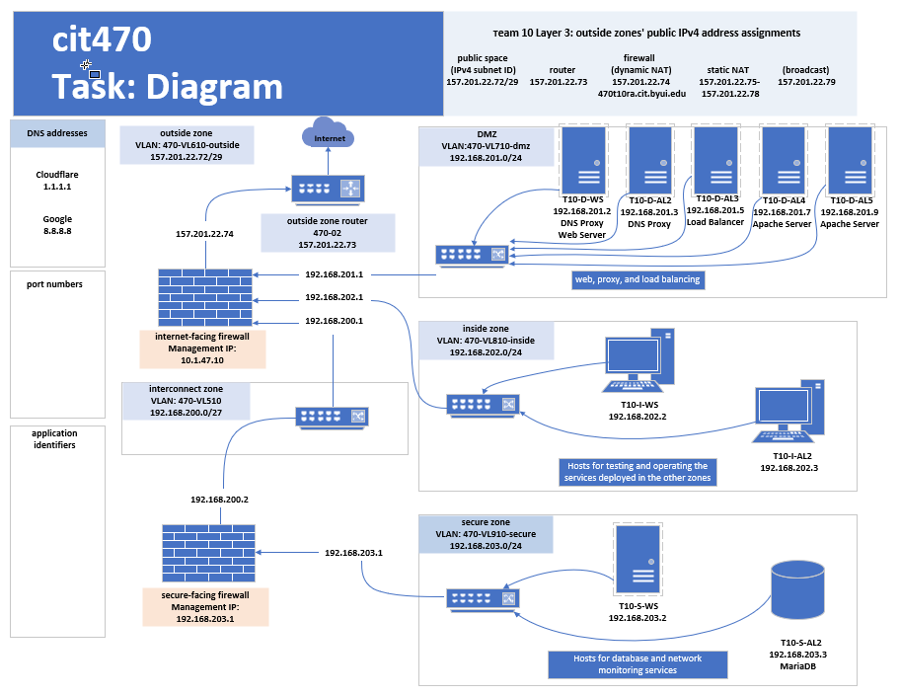
Task: Above-and-Beyond 3

Slide 3
Active Directory Installation

Slide 4
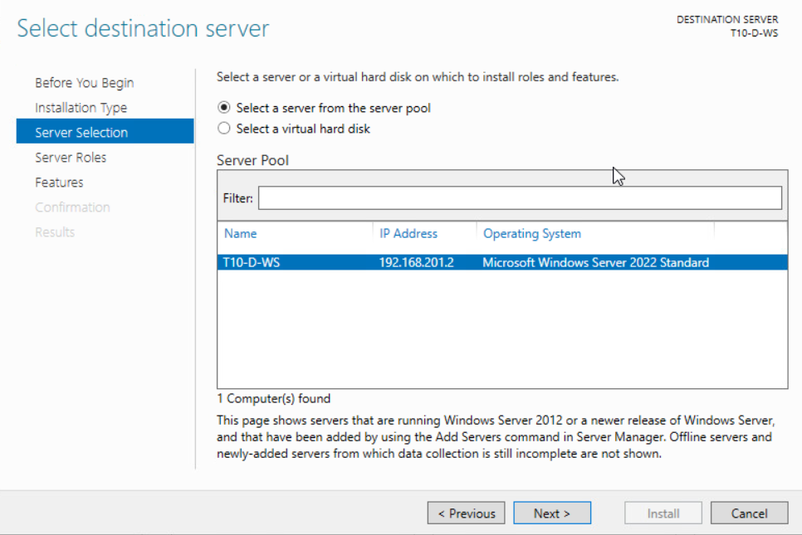

Slide 5
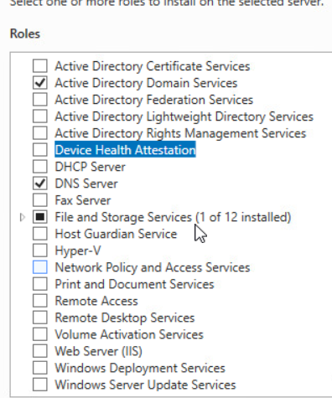
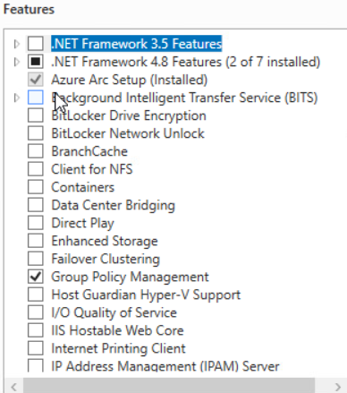
Active Directory Installation
Under “Roles”
Select the “Active Directory Domain Services” and the “DNS Server” options.
Under “Features” make sure that “Group Policy Manager” is selected.
Click Next and then click Next on the following two pages.

Slide 6
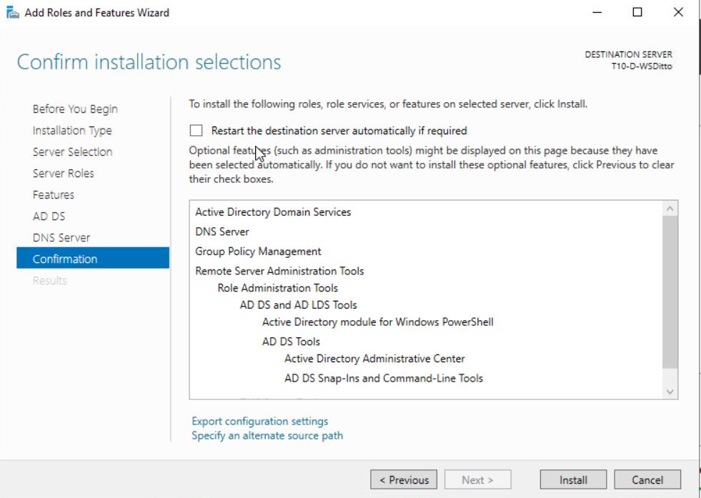
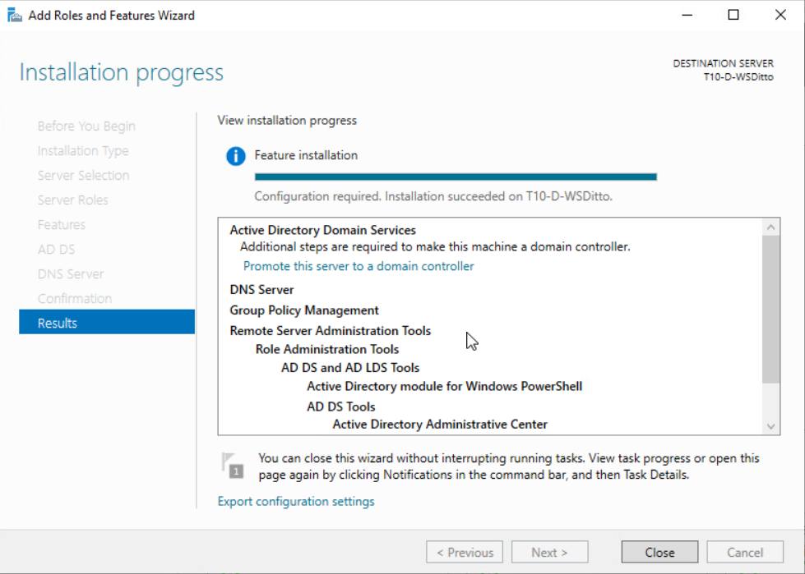

Active Directory Installation
Click “Install”
Click “Close”

Slide 7
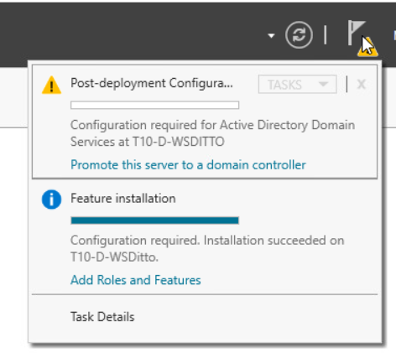
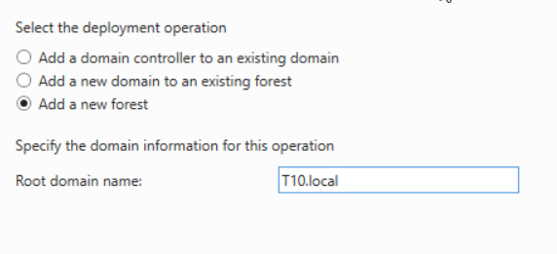
Active Directory Installation
Click on the exclamation flag and then select “Promote this server to domain controller”.
When the Active Directory Domain Services Configuration Wizard opens, Select “Add a new forest”.
Enter your Domain name and click ”Next”.

Slide 8
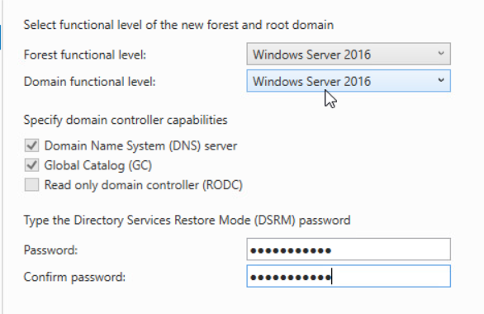
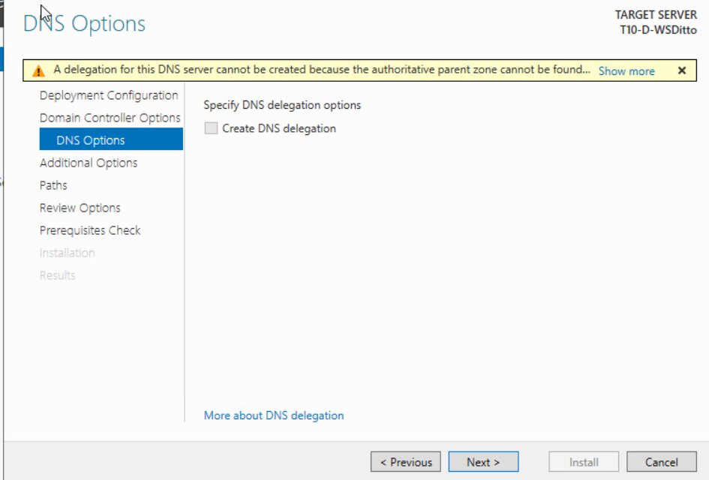
Active Directory Installation
Enter a DSRM Password
Click ”Next”
On the DNS Options page click “Next”

Slide 9
Active Directory Installation

Slide 10
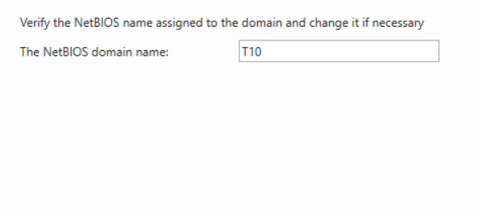
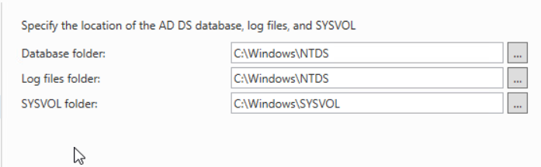
Active Directory Installation
On the other Options Page and the Paths page leave the default settings and click “Next”.

Slide 11
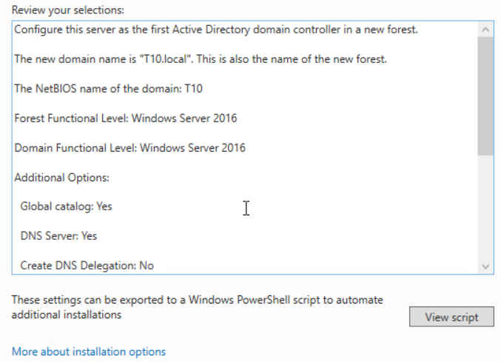
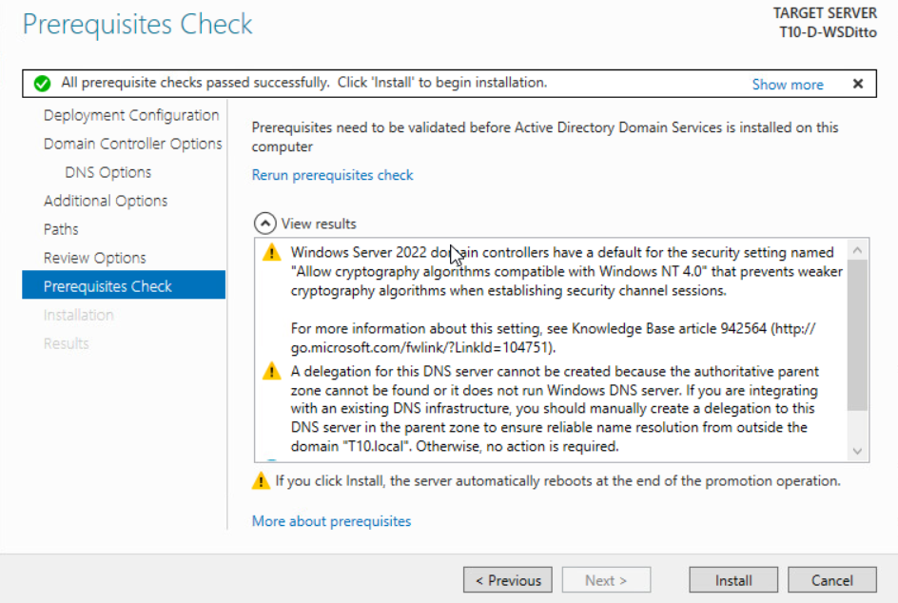
Active Directory Installation
Review options then click “Next”.
Once Prerequisite Check is completed click “Install”.
The Server will automatically restart.

Slide 12
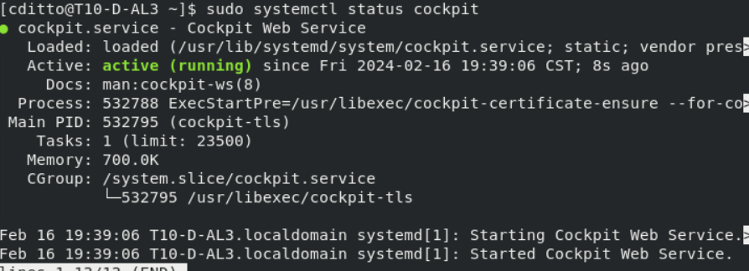
Install Cockpit

Slide 13
Install Cockpit

Slide 14
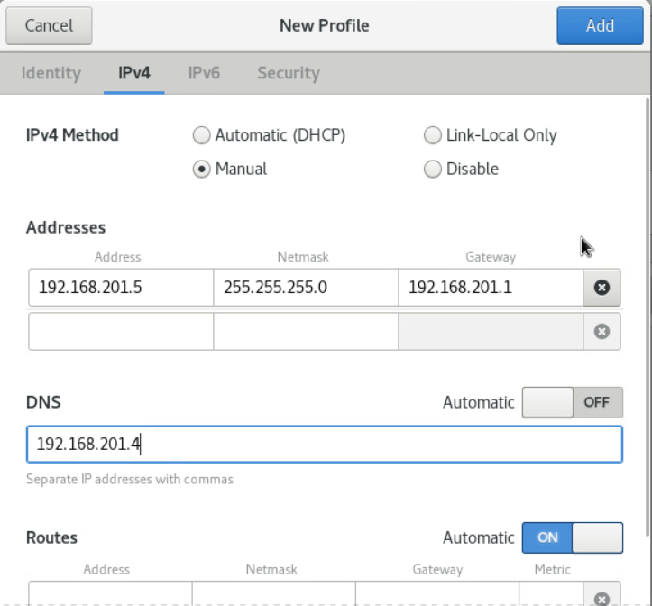
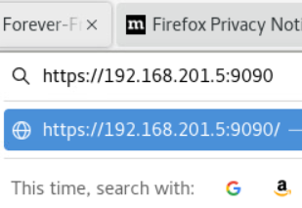
Install Cockpit

Slide 15
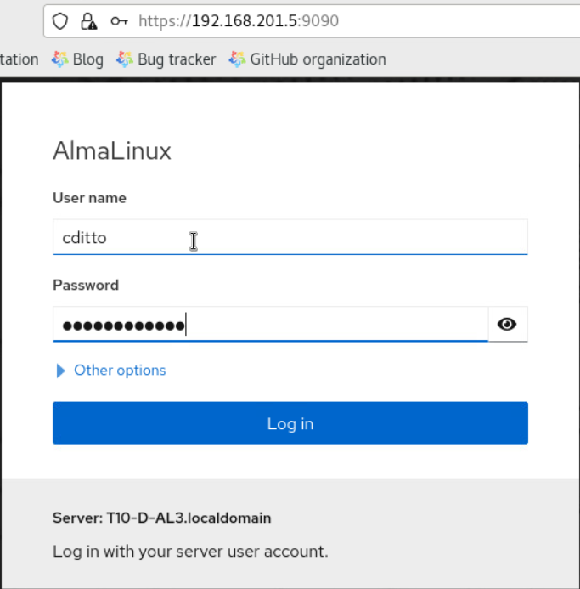
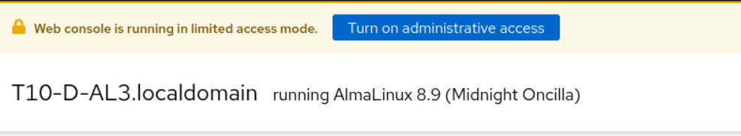
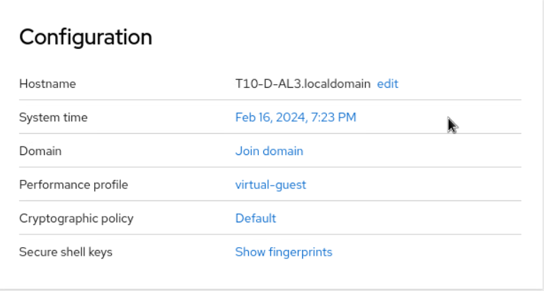
Install Cockpit

Slide 16
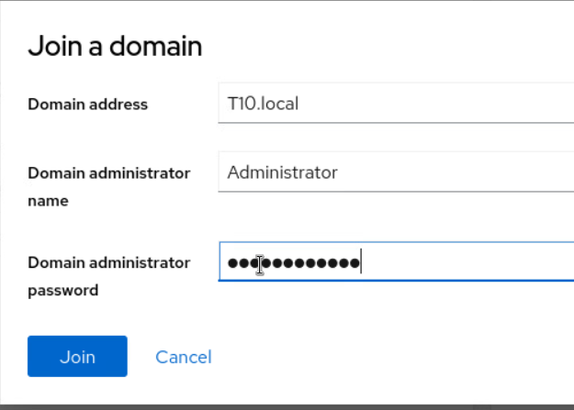
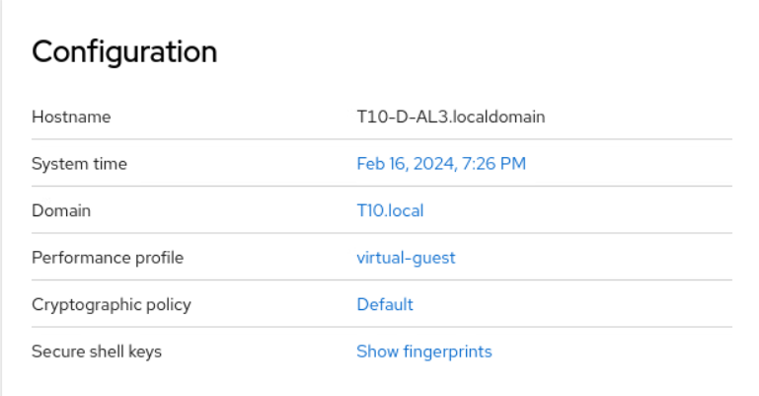
Install Cockpit

Slide 17
Install Cockpit

Slide 18
Active Directory Installation

Slide 25
Deploy an authoritative DNS server that resolves “localdomain” hostnames

Slide 26
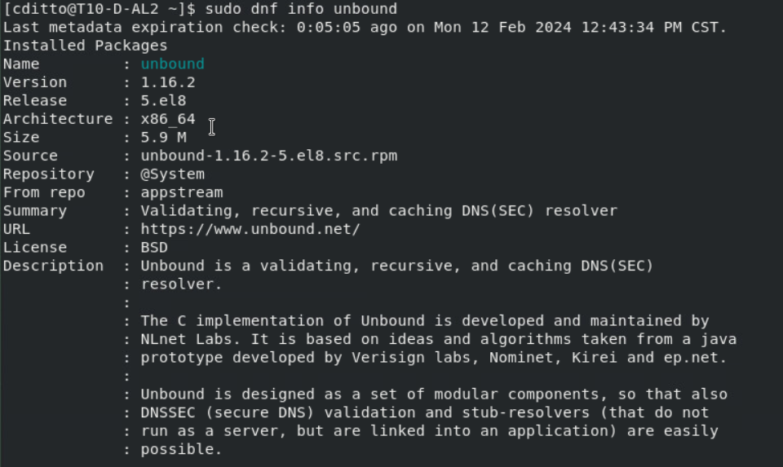
Previous to this assignment the an installation of the Unbound proxy server was installed. To view the details of that installation please see M02 Task: Proxy services.
Check info on T10-D-AL2 Unbound proxy service

Slide 27
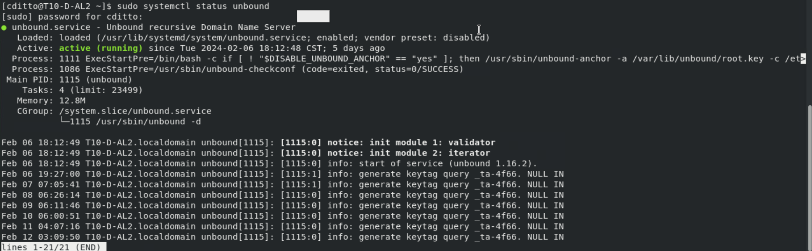
Check Unbound Status

Slide 28
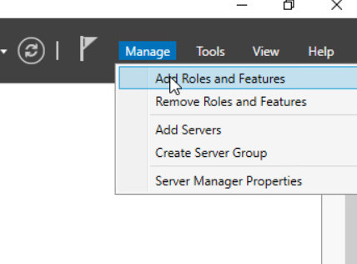
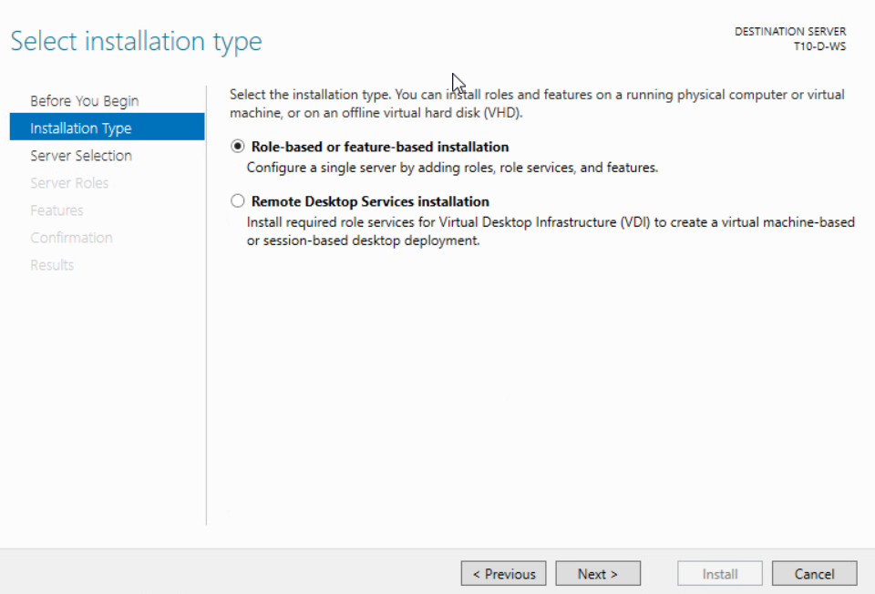
Install & Configure DHCP

Slide 29
Install & Configure DHCP

Slide 30
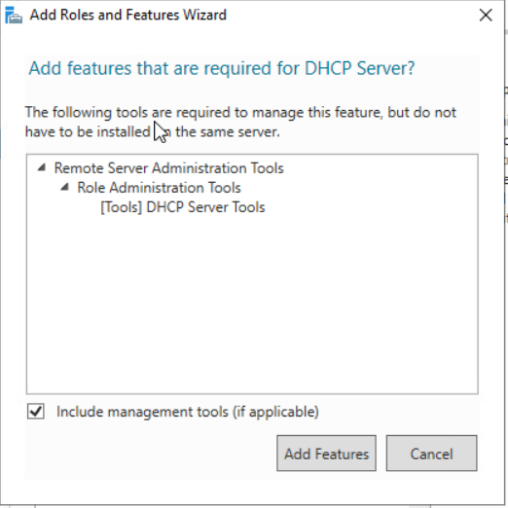
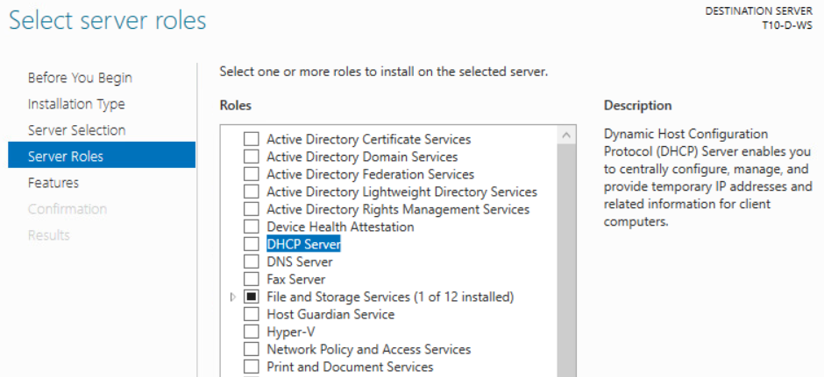
Install & Configure DHCP

Slide 31
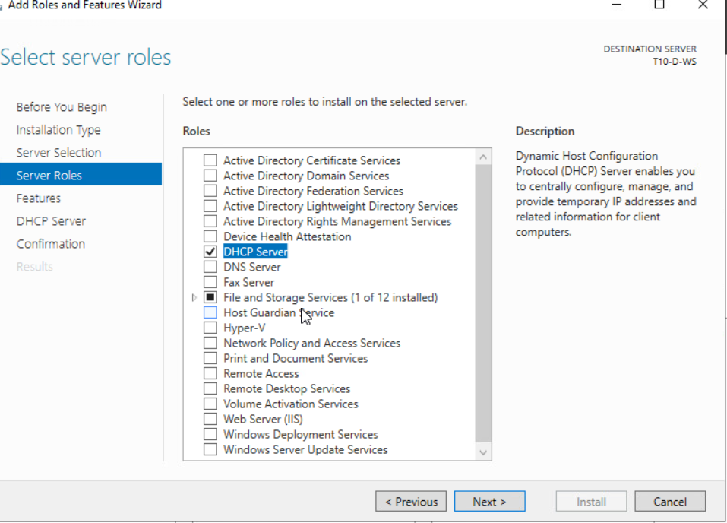
Install & Configure DHCP

Slide 32
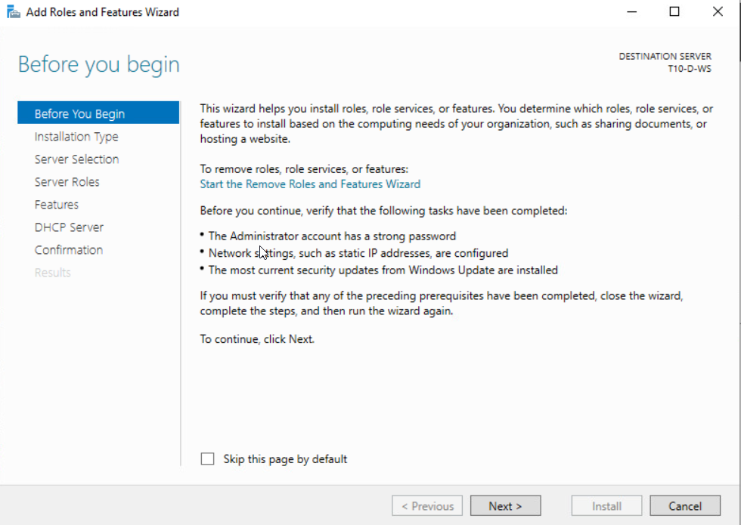
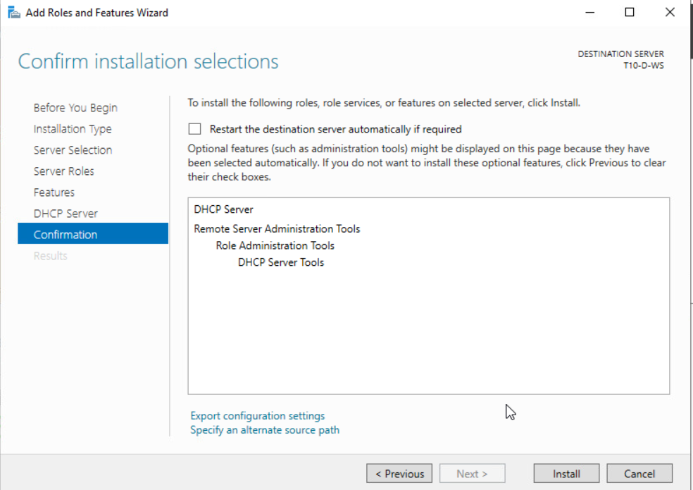
Install & Configure DHCP

Slide 33
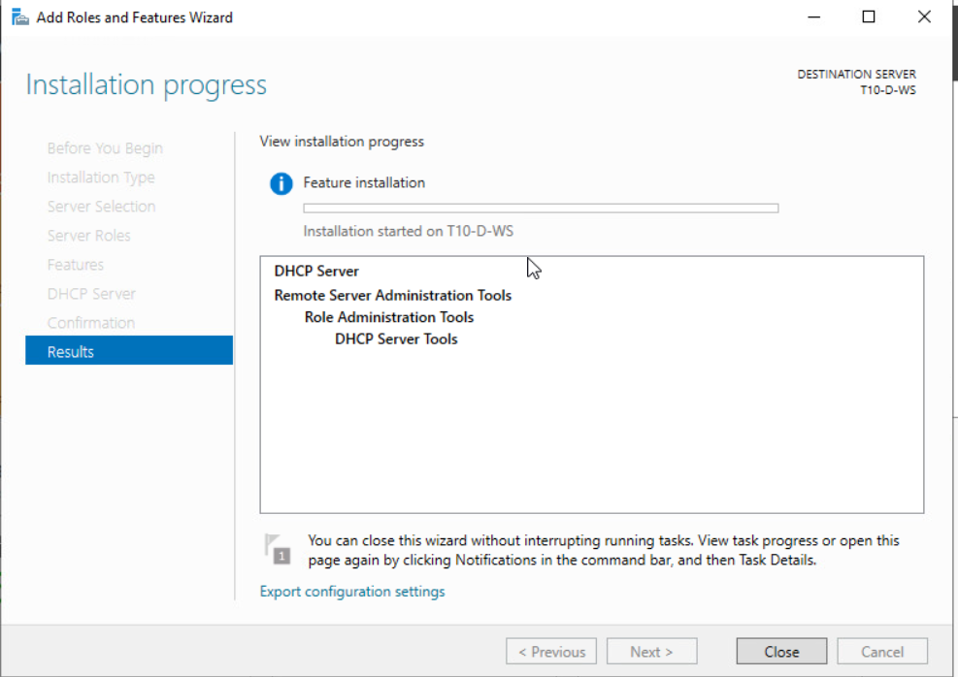
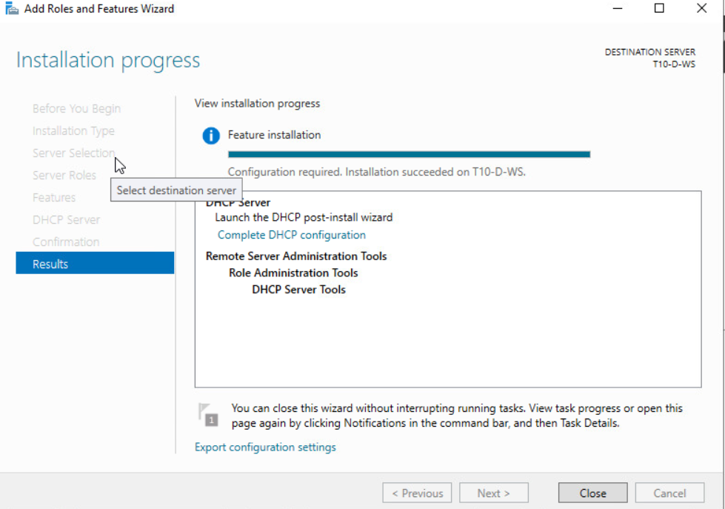
Install & Configure DHCP

Slide 34
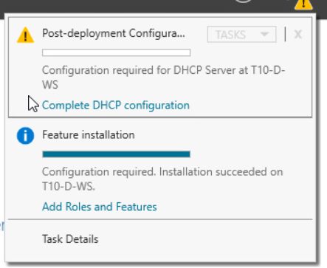
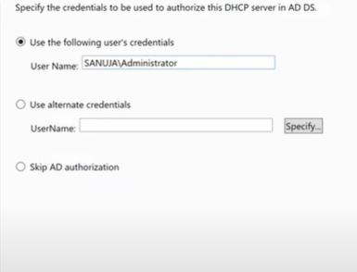
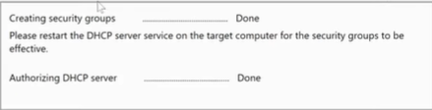
Install & Configure DHCP
T10\Administrator
TT

Slide 35
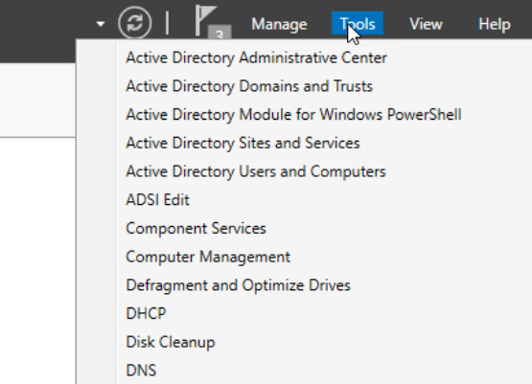
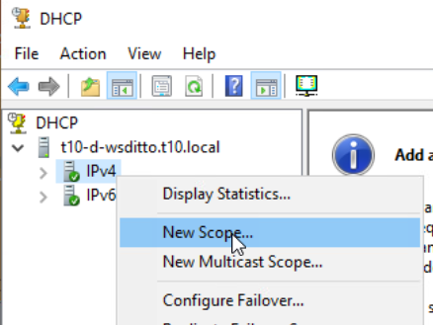
Install & Configure DHCP

Slide 36
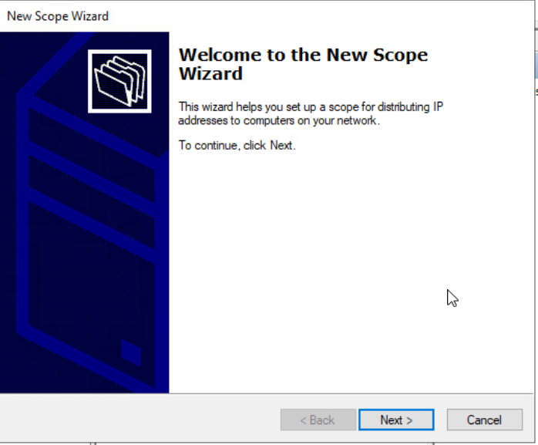
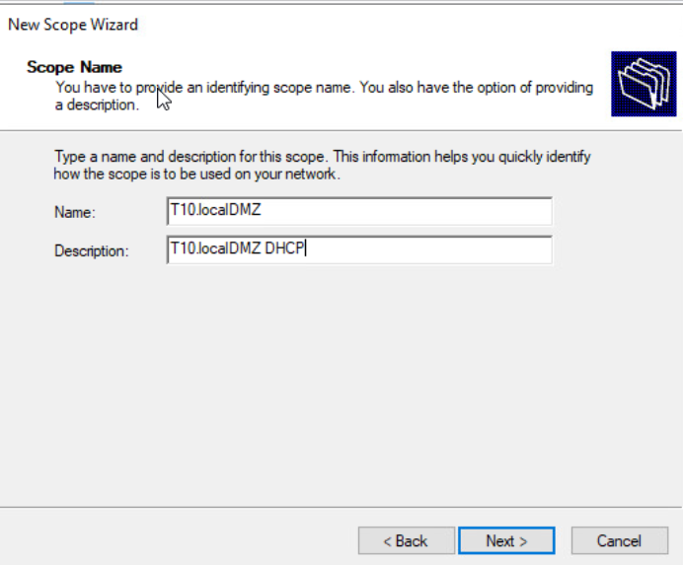
Install & Configure DHCP

Slide 37
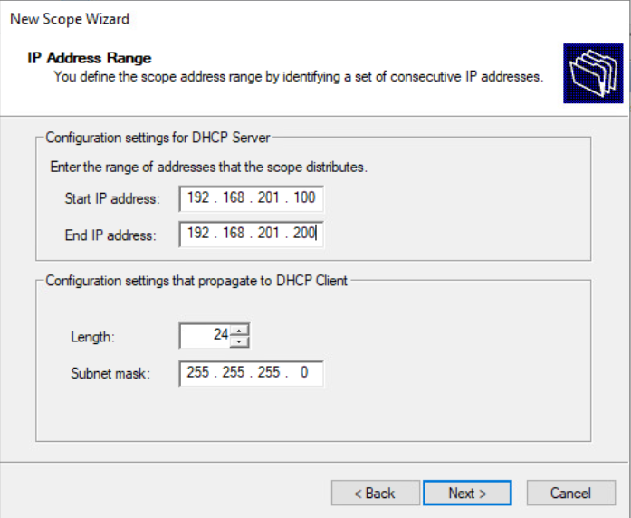
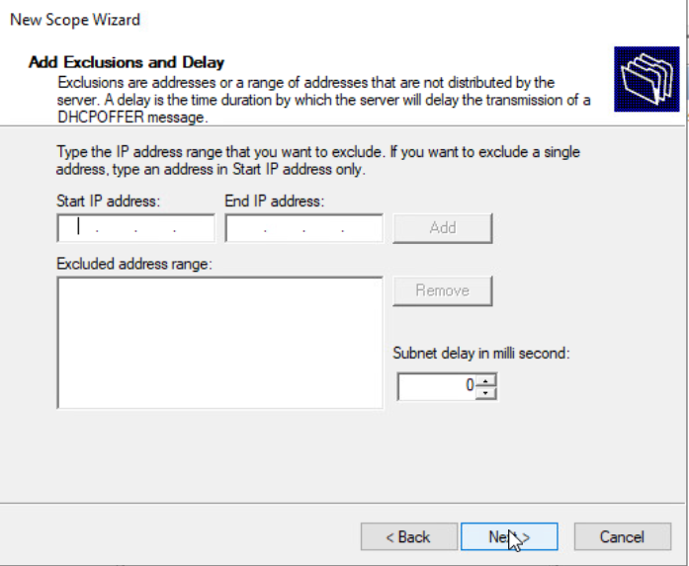
Install & Configure DHCP

Slide 38
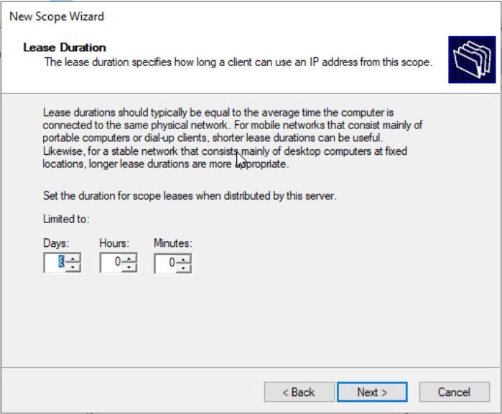
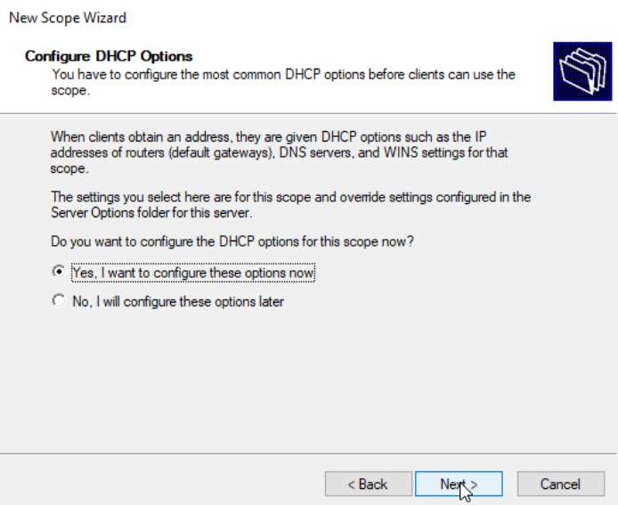
Install & Configure DHCP

Slide 39
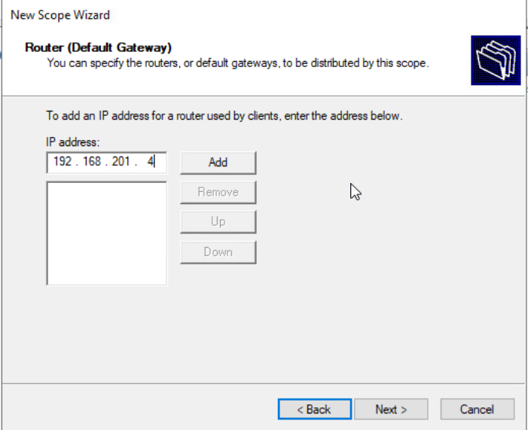
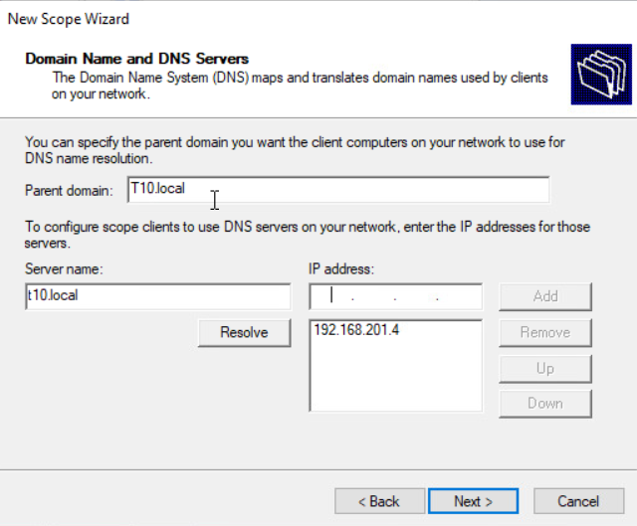
Install & Configure DHCP

Slide 40
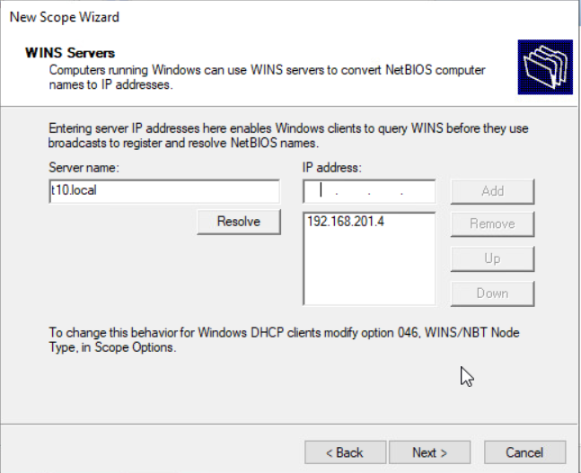
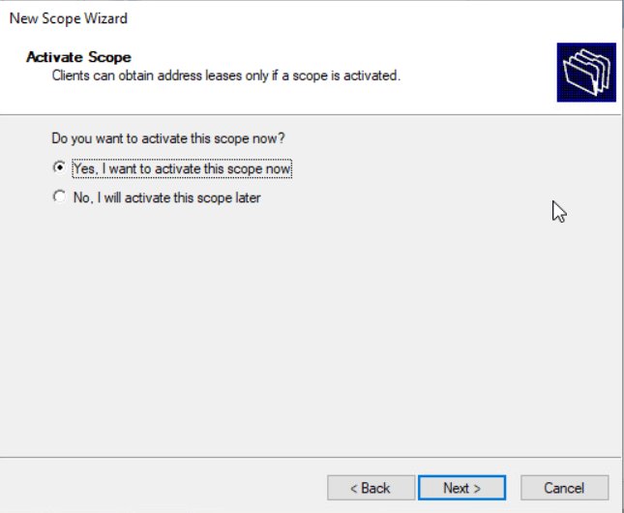
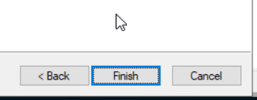
Install & Configure DHCP

Slide 41
Install & Configure DHCP

Slide 42
Install & Configure DHCP

Slide 43
Install & Configure DHCP

Slide 44
Install & Configure DHCP

